Slide 1
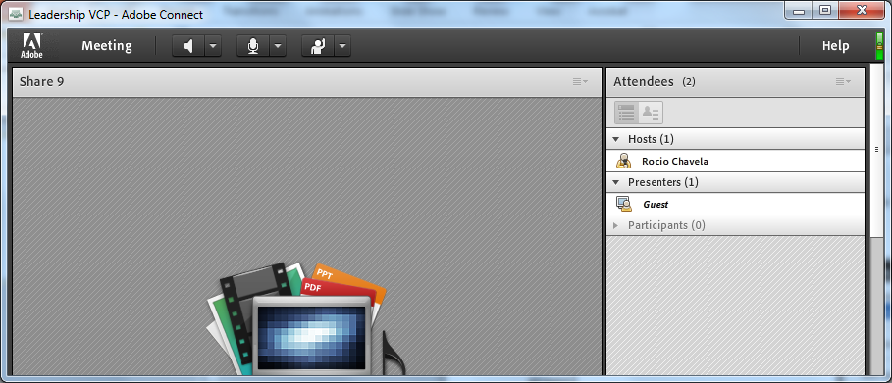
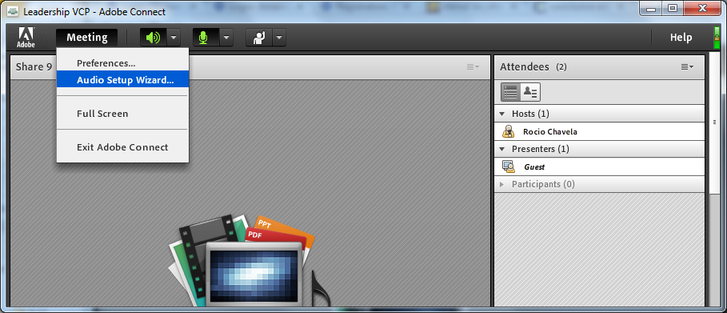
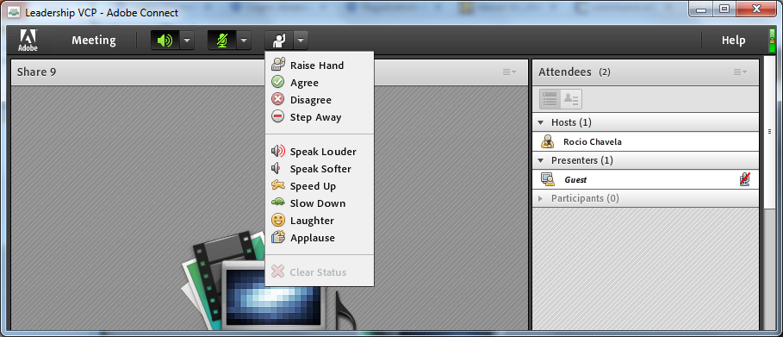
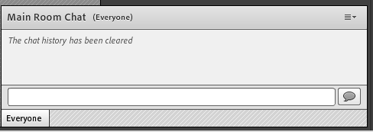
Welcome! As you enter the room, please…
Plug in your headset (if available).
Familiarize yourself with the top bar on the screen
Make sure your speakers and mic are enabled (the icons on the top bar should be highlighted on green).
Run the audio setup wizard (this option is available from the “Meeting” menu on the left right of the screen).
Once you have run the wizard, “raise your hand” by clicking on the icon available on the top bar. This will indicate hosts you are ready to test your mic.
After testing your mic, mute yourself by clicking on the mic icon on the top bar (this will help to avoid background noise).
Note: Feel free to use the chat at any time!
2
3
4
6
5

Slide 2
2016 Nakatani RIES Fellowship for JP Students
Pre-Departure Webinar
Tuesday, July 26 at 8:00 AM (Japan time)

Slide 3
Agenda
Welcome & Introductions
Nakatani Foundation
Rice Staff
Students
Overview of Schedule
Program in Japan
First Week at Rice
Research at Rice
Final Week in Washington, DC & New York City
Pre-Departure Planning
Travel
Money
Housing
Transportation
Medical
Communication
Weather
Packing

Slide 4
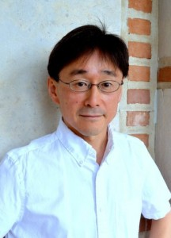
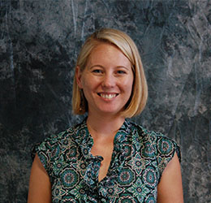
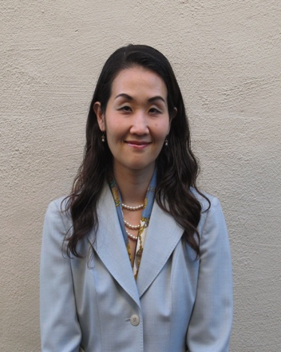
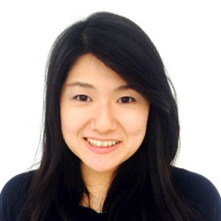
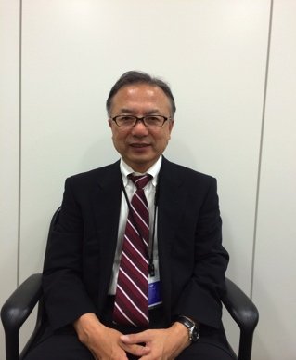
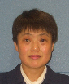
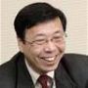
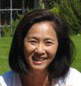
Nakatani RIES Fellowship @ Rice
Junichiro Kono
Professor, ECE, MSNE & P&A
Research Director
Sarah Phillips Education Programs Director
Aki Shimada
Education Pgms. Administrator
Keiko Kato
Grad. Student Asst.
Ph.D., MSNE
Nakatani RIES Fellowship in Japan
Kaoru Takarada
Secretary General
Utako Endo
Nakatani RIES Director
Kenji Ogawa
Program Facilitator
Keiko Packard, JP Pgm. Director

Slide 5
Keiko Kato Introduction
Ph.D. Student in Materials Science & NanoEngineering, Ajayan Lab, Rice University
Graduate Student Assistant, Nakatnai RIES Fellowship for Japanese Students

Slide 6
Student Introductions
Turn your microphone and video on
Introduce yourself (Name, university, major)
What lab will you be working in at Rice and what will your research project be (if known)?
Other than research, what is one thing you are looking forward to doing in the U.S.?

Slide 7
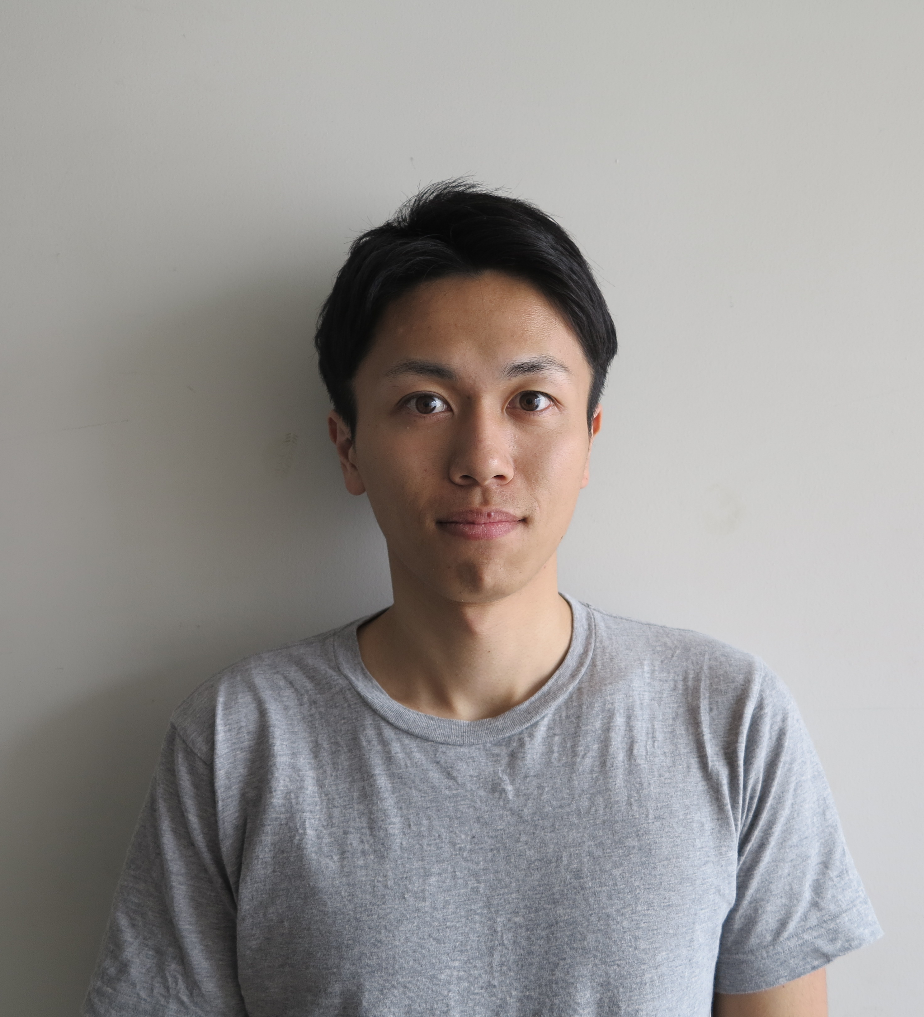
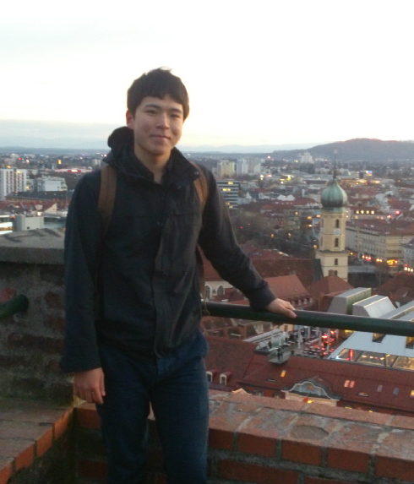
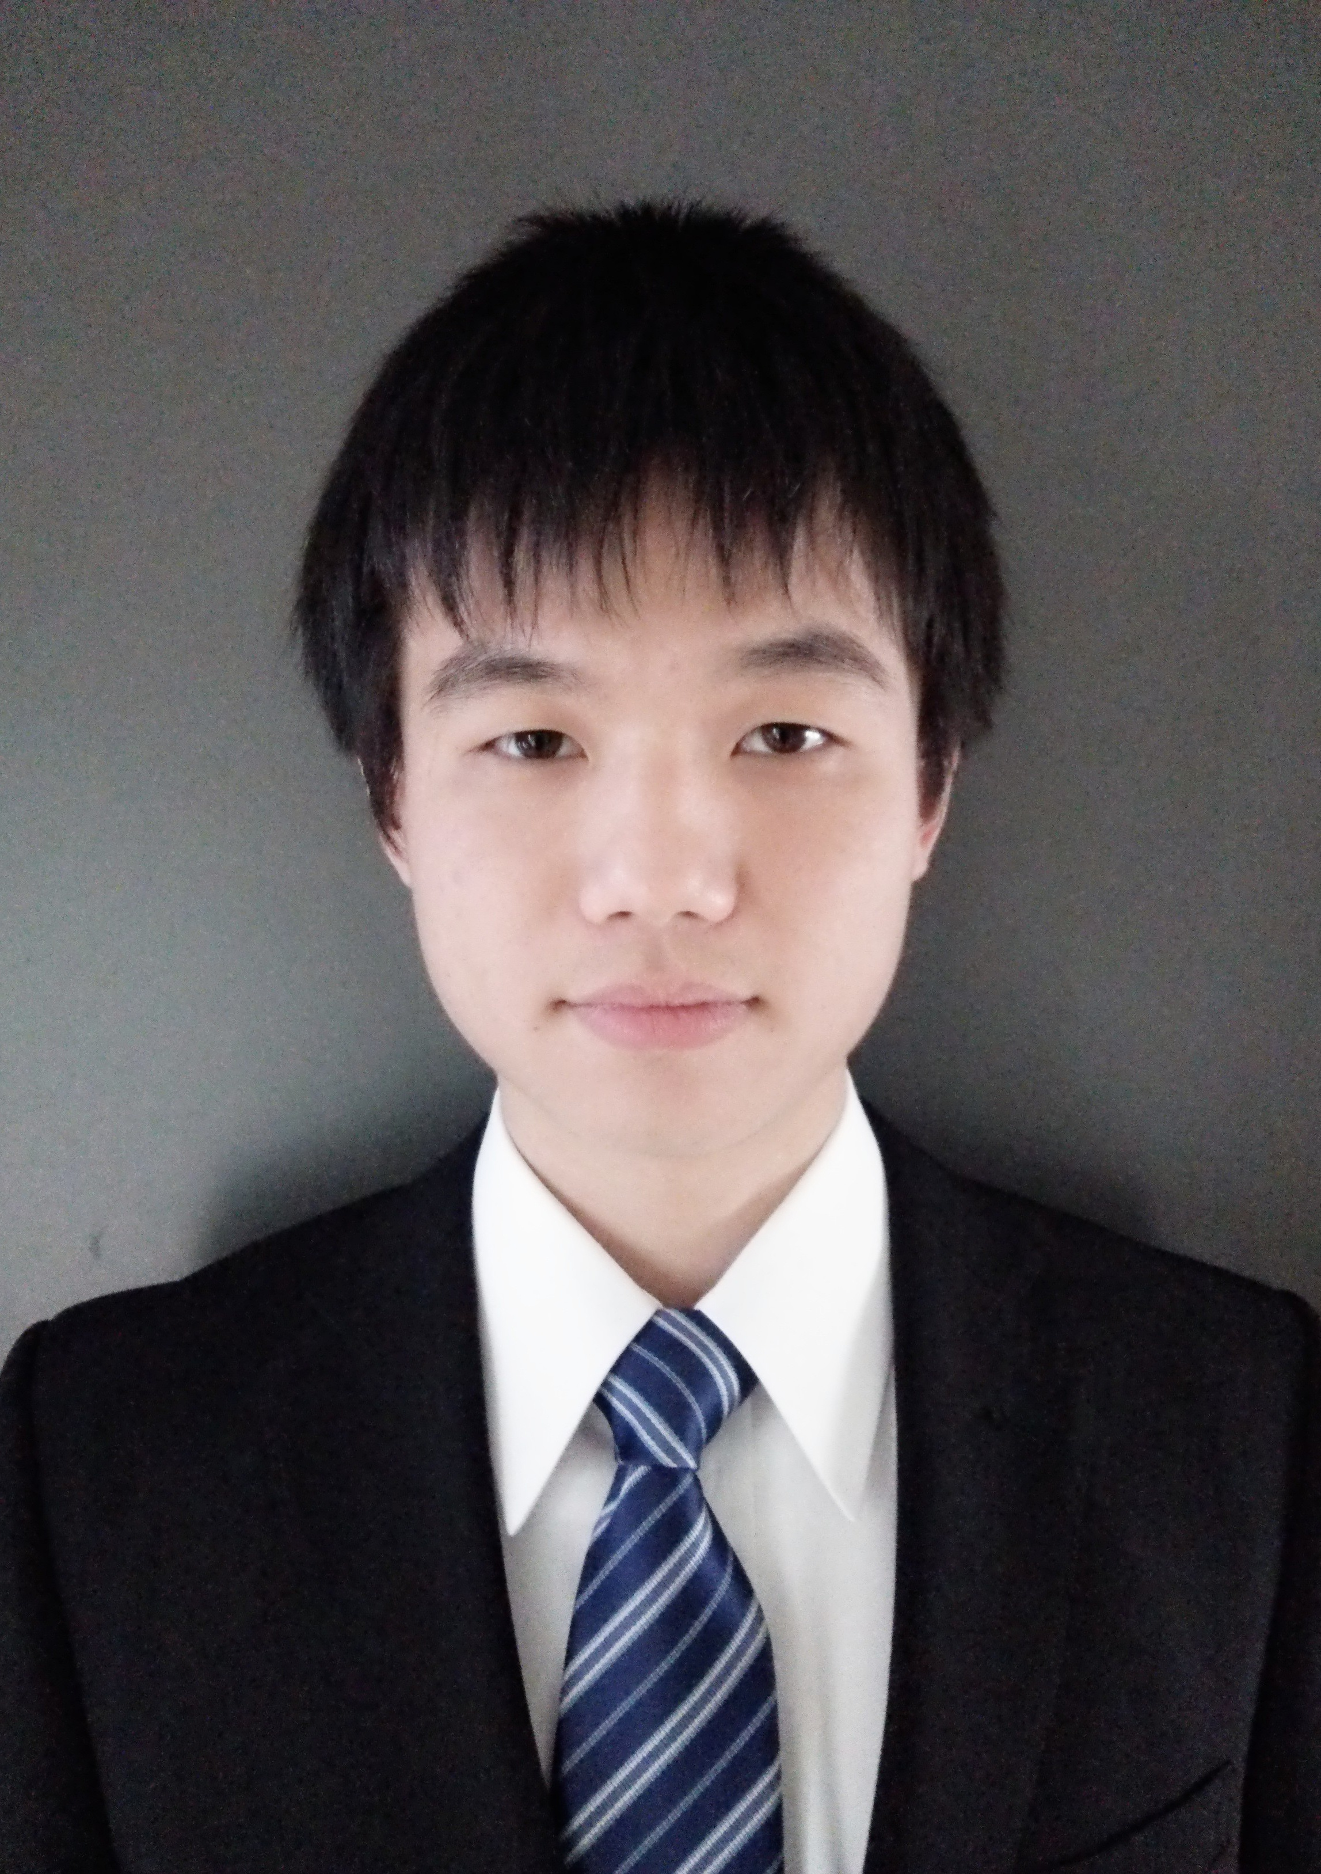
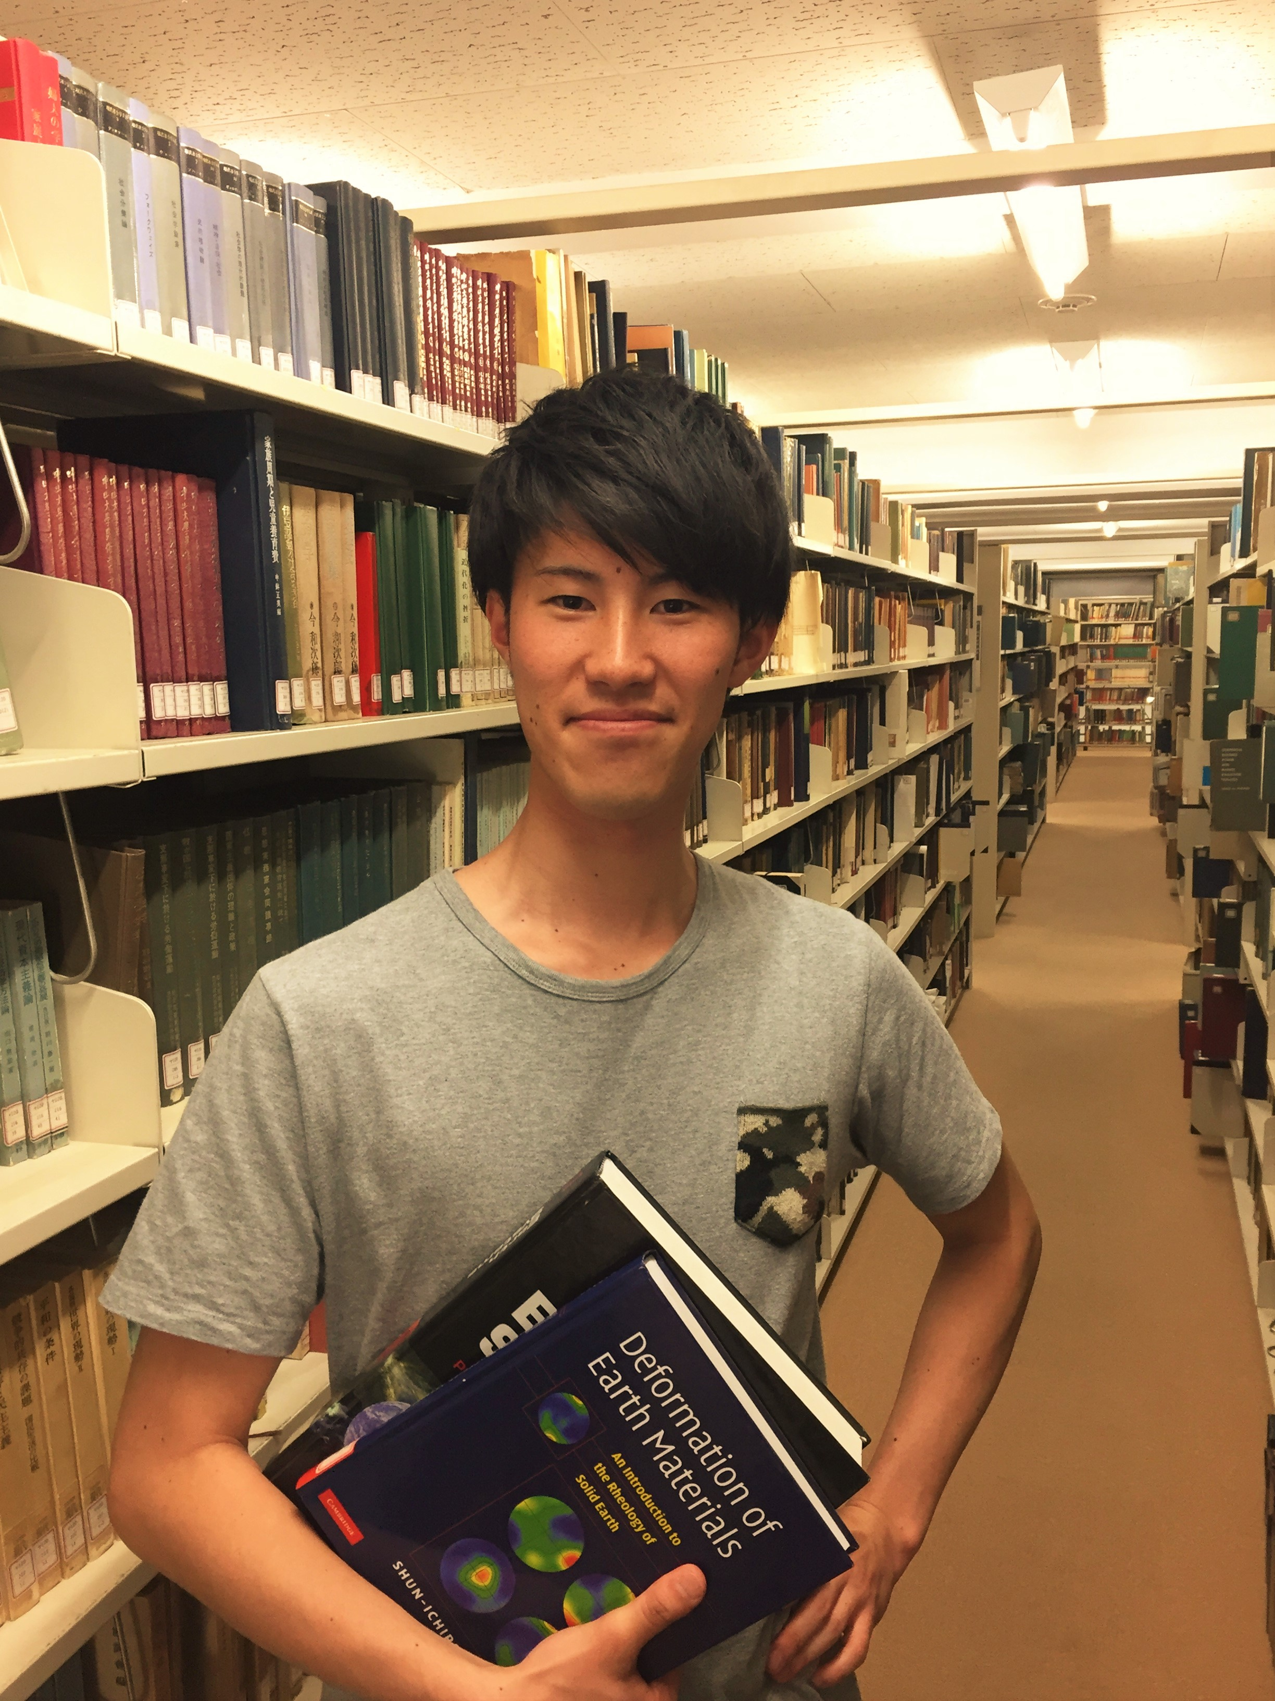
2016 Japanese Fellows
Hiromi Miwa
Keio University Applied Chemistry
Host Lab: Bao Lab, Bioengineering
Soya Miyoshi Tohoku University
Electrical, Information and Physics Engineering
Host Lab: Zhong Lab, Electrical & Computer Engineering
Nobuyoshi Hiramatsu University of Tokyo
Applied Physics
Host Lab: Kono Lab, Electrical & Computer Engineering
Takuya Kurihana
University of Tskuba Atmospheric Science
Host Lab: Heinkenschloss Lab, Computational & Applied Mathematics

Slide 8
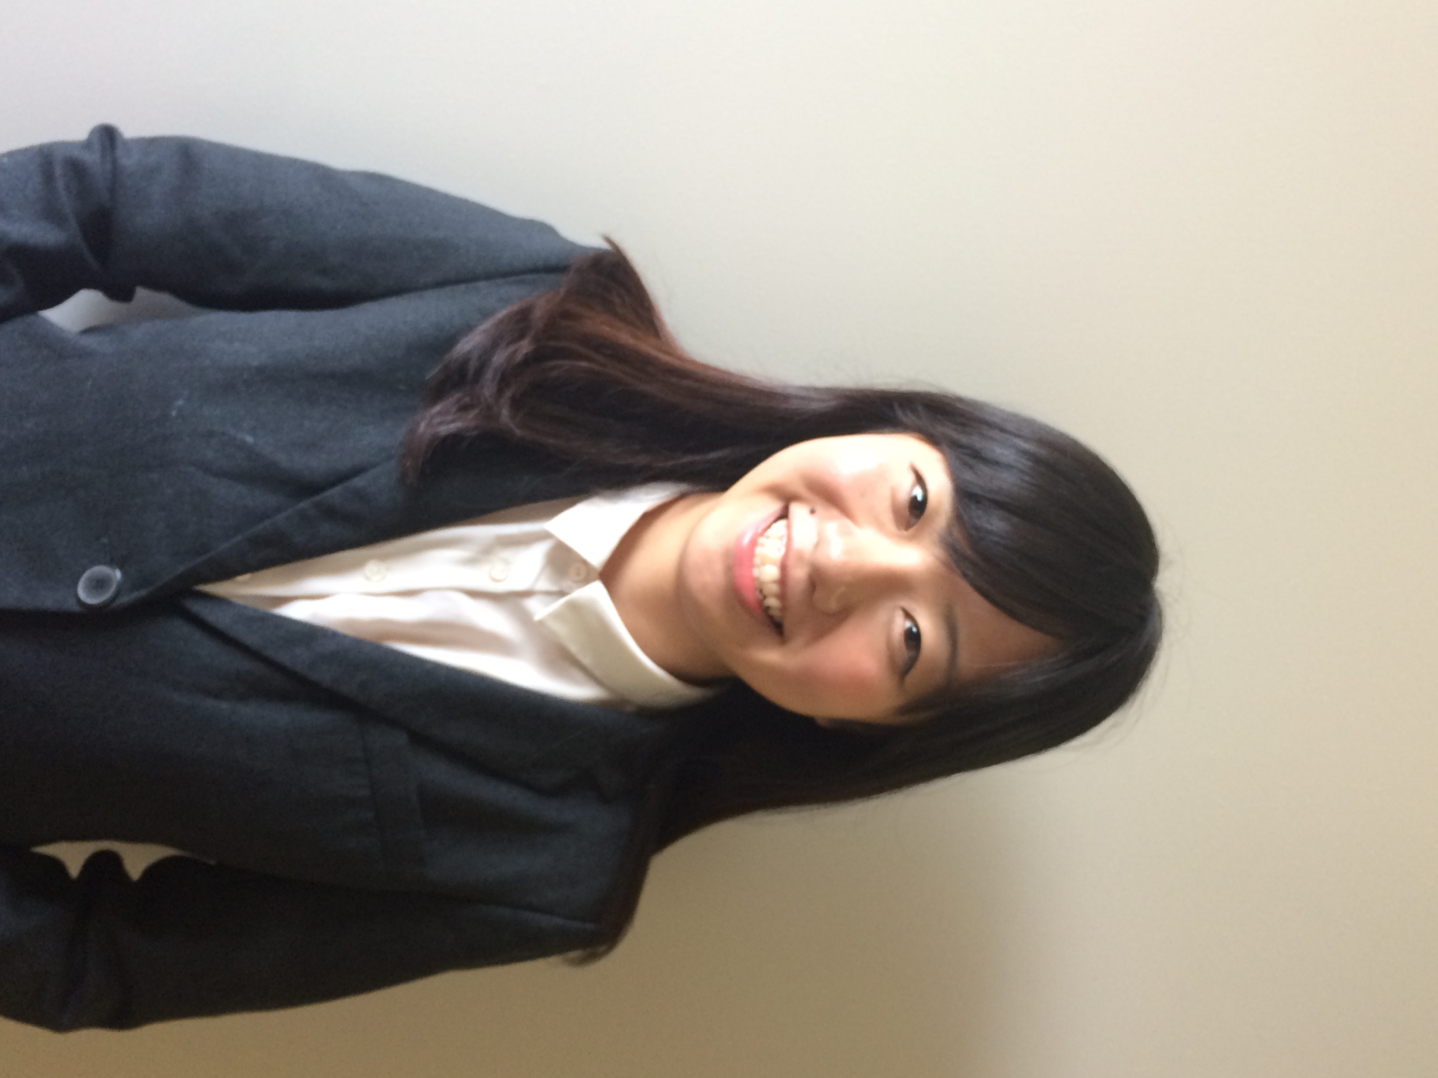
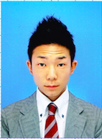
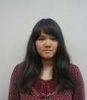
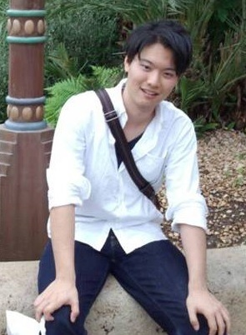
2016 Japanese Fellows
Yunong Wang Toyota Technological Institute Materials Science Host Lab: Li Lab, Civil & Environmental Engineering
Ayaka Yoshida Waseda University Modern Mechanical Engineering
Host Lab: Tezduyar Lab, Mechanical Engineering
Toshihiro Takada Ristumeikan University Environmental Systems Engineering
Host Lab: Ajayan Lab, Materials Science & NanoEngineering
Tatsuya Tanaka Waseda University Mechanical Engineering
Host Lab: Tezduyar Lab, Mechanical Engineering

Slide 9
Overview of Nakatani RIES Fellowship
View Message from the Nakatani Foundation President:
http://nakatani-ries.rice.edu/files/2016/01/Message-from-the-President-160115-2duu2pr.pdf
Notes:
Cheryl will give a general overview of PIRE and the educational goals/objectives of our PIRE. Jun will focus on the research during the Pre-Departure Orientation at Rice.

Slide 10
Nakatani Foundation
Established in 1984 as the Nakatani Foundation for Advancement of Measuring Technologies in Biomedical Engineering
Conducts activities that contribute to Japan’s economic & social development and invest in improvement of people’s lives through broad development of biomedical engineering measuring technologies
Grants & programs for natural science education and junior/senior high schools in Japan
In 2016 will expand scope of activities: beyond Japan to the world and beyond jr./sr. high school to university students through the establishment of the Nakatnai RIES: Research & International Experiences Fellowship for U.S. & Japanese students

Slide 11
Nakatani RIES Fellowship for JP Students
Cultivate an interest in science and engineering research and research collaborations between the U.S. and Japan;
Nurture the next generation of science and engineering students in Japan;
Contribute to the development of a generation of internationally savvy Japanese students who have a specific interest in and knowledge of the U.S.; and
Educate students in culture, language, and technology, in order that they may be more effective when addressing global scientific problems.

Slide 12
Program Schedule
Overview

Slide 13
Program in Tokyo
Sunday, August 7, 2016
U.S. & Japanese Fellows arrive by Sunday evening and check-in to Sanuki Club Hotel (http://sanuki-club.tokyo/)
Monday, August 8, 2016, Joint Seminar Day
9:00 – 12:00 PM: Sanuki Club Conference Room, 3rd Floor
Self-Introduction (in English)
Ice-breaker Activities
Student Discussion Session
Lunch (Pay Individually)
Travel to Aoyama IVY Hall via Subway (pay individually)
3:00 – 5:00 PM: Meeting with Nakatani Foundation President & Board Members
U.S. & JP Fellows Give a Short Introduction (in English & Japanese)
5:00 – 6:30 PM: Party & Networking Event

Slide 14
Program in Tokyo (cont.)
Tuesday, August 9, 2016: JP Fellows Pre-Departure Day
9:00 – 12:00 PM, Sanuki Club Conference Room, Third Floor
Health & Wellness Orientation with discussion of Health Insurance & Travel
Lunch: Pay Individually
Afternoon: “Importance of Global Research Experiences for Japanese Students”
Seminar by Nakatani Board Member
Talk by Japanese Student who has conducted research at Rice University
Open discussion session with students
Wednesday, August 10, 2016: Travel to the U.S.
Travel via subway to Shinagawa Station (pay individually)
Nakatani will provide Narita Express tickets departing from Shinagawa
11:15 AM: Depart Narita Airport on NH #174. Takarada-san will travel with you.
Gain 1 day as you cross the international date line
Arrive in Houston (IAH) at 9:30 AM

Slide 15
Arrival at Rice
Wednesday, August 10, 2016 in Houston
9:30 AM: Arrive Houston (IAH) Airport
Clear immigration & customs at IAH
Shuttle transportation to hotel
~ 12:00 PM: Check-in to Residence Inn Hotel
2:00 PM: Depart Hotel to get Rice University Student ID Card & meal cash stipend check at Chase bank
3:00 PM: Shuttle from bank to Target department store
Can purchase food, laundry soap, personal supplies, clothes, cell phones, etc. at Target.
Return to Hotel
6:00 – 7:30 PM: Free evening reception in hotel lobby with light food and drinks.

Slide 16
Arrival at Rice (cont.)
Thursday, August 11, 2016
8:30 AM: Depart Hotel
9:00 – 10:30 AM: Check-in with Rice’s Office of International Students & Scholars
Bring passport & DS-2019
Bring English language translation of Japanese health insurance
10:30 – 11:30 AM: Campus Tour
Will be hot & humid! Bring water bottle, hat, umbrella, and wear sunscreen.
1:30 – 2:30 PM: “Introduction to Graduate Study in the U.S.”, Prof. Junichiro Kono
2:30 – 3:30 PM: Panel Discussion with Japanese Graduate Students at Rice, Facilitated by Keiko Kato
4:00 PM: Shuttle Pick-up

Slide 17
Arrival at Rice (cont.)
Friday, August 12, 2016
8:30 AM: Depart Hotel
Morning: “Introduction to U.S. Culture”, Sarah Phillips
12:00 – 1:30 PM: Attend U.S. Fellows Poster Session at the SCI Summer Research Colloquium
Afternoon: Attend Oral Presentations by Graduate Students at the SCI Summer Research Colloquium
Hotel shuttle back in evening
Saturday, August 13, 2016
Day: Joint Trip to NASA: Johnson Space Center with U.S. Fellows
Evening: Party at Prof. Kono’s Home
Sunday, August 14, 2016
US Fellows Return Home
Free/Rest Day for JP Fellows
Free hotel shuttle to nearby locations such as Hermann Park. Houston Museum of Natural Science, etc.

Slide 18
First Week of Research
Monday, August 15, 2016
Day: Meetings with Research Host Lab Professors/Mentors
Confirm research project/topic
Ask about any training you may need.
Confirm what your expected work hours are in the lab
3:30 – 5:00 PM: “Introduction to Research Presentations”, Dr. Beata Krupa
Discussion of experience at SCI Colloquium on August 12
Preparation for 5 – 7 minute final research project presentation that will be given on September 16 at Rice
Evening: Hotel shuttle back to Residence Inn
Tuesday, August 16
General Lab Safety Training (All) & Laser Safety Training
Wednesday, August 17
Graduate Student Activities Fair & Cookout
Thursday, August 18
Biological Lab Safety Training
Saturday, August 19
Rice University Welcome Back party (classes start on Aug. 22)

Slide 19
Research at Rice: August 16 – Sept. 15
See Research at Rice Resources: http://nakatani-ries.rice.edu/resources/for-japanese-students/resources-research-in-the-u-s/
Each student will be paired with a graduate student mentor/s
Research will be conducted in English
Working hours in lab will vary and will match that of your graduate student mentor/s
Keep a good Research Lab Notebook
Homework
Final research presentation on Sept. 16
Weekly research internship reports
Similar to the TOMODACHI STEM reports. See http://tomodachistem.blogs.rice.edu/participants/
You will be expected to attend at least 1 research seminar of your own choosing in your academic department or an area of interest while at Rice.

Slide 20
Weekly Seminars: August 16 – Sept. 15
Aug. 11: “Academic Careers & Graduate Study in the U.S.”, Prof. Junichiro Kono, ECE
Aug. 11: “Graduate Study in the U.S.: Japanese Student Panel Discussion”, Facilitated by Keiko Kato, Ph.D. Student, MSNE
Aug. 15: “Presenting on your Research”, Dr. Beata Krupa, Rice Center for Engineering Leadership
Date TBA: “U.S. – Japan Relationship Through Baseball”, Prof. Sayuri Shimizu-Guthrie, Dept. of History
Date TBA: “Introduction to the Baker Institute for Public Policy’s Science & Technology Policy Program”, Prof. Neal Lane & Dr. Kirstin Matthews, Baker Institute for Public Policy
Date TBA: Connection between University Research & Entrepreneurship in the U.S., Company Talk, Date TBA
Sept. 13 & 14: Research Presentation Re-fresher and One-on-One Presentation Coaching Sessions, Dr. Beata Krupa, Rice Center for Engineering Leadership

Slide 21
Other Activities at Rice
OISS English Language Classes
Volunteer taught, non-credit bearing
Network with other Rice international students
Rice Japanese Language Program
Join the ‘Japanese Lunch Table’ where Rice students who are learning Japanese talk with native speakers (Dates TBA)
Student Activities @ Rice: Must attend 1 meeting/event
Student Club Listing: http://studentcenter.rice.edu/student-activities/student-organizations/find-a-club/
Attend other Campus Activities (optional)
Campus Calendar: http://events.rice.edu/

Slide 22
Cultural Outings/Activities in Houston
Keiko Kato will help lead/join with some fun outings and activities in Houston.
Aug. 13: Joint Outing to NASA with U.S. Fellows
Aug. 13: Welcome Party at Prof. Kono’s home
Other possible outings may include:
Houston Zoo or Houston Museum of Natural Science (free with Rice ID)
Houston Astros Baseball Game or Houston Texas Football Game
Miller Outdoor Theater Events in Hermann Park (Free)
Other music or community events
Houston Restaurant Week with JET Program Alumni in Houston
Organized by Alisa Tobin at the JP Consulate. JET alumni will pick you up and take you for various restaurants during this special week in Houston when there are set menus for an inexpensive price.

Slide 23
Washington, DC
Saturday, Sept. 17
Check-out of Houston hotel and group flight to DC
Sarah will be on the same flight and their will be 1 other advisor attending this trip
Sunday, Sept. 18
Sight-seeing in DC
Many monuments & museums are free. Pay for subway transportation.
Monday, Sept. 19 & Tuesday Sept. 20 (tentative)
JSPS Washington DC Office
Office of Science & Technology Policy at White House or NSF Headquarters
Campus Visits & Lab tours at Howard University & Johns Hopkins

Slide 24
New York City & Return to Japan
Wednesday, Sept. 21
Fly to NYC
Sight-seeing in Central Park in late afternoon
Thursday, Sept. 22 & Friday Sept. 23 (tentative)
Campus Visits & Lab Tours at Columbia University
STEM Career Session/Panel
Possible visit or talk about UN Science & Technology Initiatives
Saturday, Sept. 24
Depart NYC for Tokyo (lose 1-day as you cross int’l date line)
Sunday, Sept. 25
Arrive Tokyo, stay at Sanuki Club
Monday, Sept. 26
Nakatani Closing Ceremony in Tokyo

Slide 25
Pre-Departure Planning
Steps to help you prepare for coming to the U.S.
Ask questions at anytime!

Slide 26
Money in the U.S.
Costs paid by Nakatani RIES
Costs you Pay Individually
Passport, visa & SEVIS fees
Meals
Use $800 meal stipend. Anything over this you pay for individually
Free hot breakfast at hotel & all rooms have full kitchen
U.S. Cell Phone
$25 for phone & 500 minutes valid for up to 60 days
Daily Transportation
Free hotel shuttle in Houston
Pay individually for subway in DC & NYC
Free sight-seeing
Personal Expenses, Shopping, etc.
Airfare & Airport Transportation
Hotel lodging (double-occupancy) in Houston & DC
App. Fee, Registration & Tuition as Non-Degree Visiting UG Research Student
Supply stipend for your lab
Some cultural activity/outing costs

Slide 27
Money in the U.S. (cont.)
Prior to departure, contact your bank to
Inform them of the dates you will be traveling in the U.S.
Confirm if/how you can use a debit card to withdraw money from your Japanese bank account using a U.S. ATM
Confirm what your daily withdrawal rate is for getting cash out of an ATM In the U.S. (remember the exchange rate)
Receive $800 meal stipend check upon arrival in Houston
Cash at nearby bank.
Consider the TravelEx Pre-Paid Mastercard to bring personal funds with you to the U.S.
Obtain in Japan prior to departure, put money on card that you can w/draw or use in USD while abroad
http://www.travelex.co.jp/JP/For-Individuals/Products-and-Services/Cash-Passport/Multi-Currency-Cash-Passport/
Opening a U.S. Bank Account
Not recommended for such a short stay in the U.S. unless you have a plan to return to the U.S. very soon
https://oiss.rice.edu/uploadedFiles/Docs/NEW%20Opening%20a%20Bank%20Account.pdf

Slide 28
Money in the U.S. (cont.)
Personal Spending: Recommendation of $800 - $1,500 available
Consider your personal spending habits.
$800 meal stipend works out just ~$17/day for 46 days in the US.
Anything above this you pay for individually.
To save money plan to cook on your own while in Houston.
Need to use personal funds for:
Taxis/Ubers/Subway when free hotel shuttle not available
Personal Shopping
Personal Sight-seeing/outing costs
Souvenirs
Note: During the week we are in DC & NYC a free hot breakfast will be provided at the hotel but there will not be a kitchen in the room. You will need to plan to eat out for all lunches & dinners this week.

Slide 29
Health Insurance
Health Insurance for Japanese Students in the U.S.
Purchased for you by Nakatani Foundation
Meets all minimum requirements for J-1 visa holders in the U.S.
Health Insurance staff will discuss coverage and how to use policy in Tokyo on August 9
If you need medical treatment, call the insurance phone number (24/7) and they will help arrange an appointment
Types of Medical Care in the U.S.
Minor Illness
Go to a doctor’s office or Urgent Care Center
Life-threatening emergency
Dial 911 (off-campus) or x6000 (Rice on-campus) for an ambulance to be sent to your location.
Ambulance will take you to the nearest hospital emergency room
Rice OISS Tips for Using Health Insurance in the U.S.
https://oiss.rice.edu/uploadedFiles/Docs/Health%20Insurance%20Tips.pdf

Slide 30
Medical Care in the U.S.
If you get sick while in Houston, call Aki Shimada
If you get sick while in DC or NYC, call Sarah Phillips
OTC Medical Kit
Helpful to bring your own medical kit with common OTC medications you might need for headache, cold, fever, bandages, etc. The name brands and dosages in the U.S. may be different from what you are used to in Japan.
Stay Healthy!
Get plenty of sleep.
Stay well-hydrated. Drink plenty of water.
Try to maintain a balanced diet and eat vegetables regularly.

Slide 31
Housing:
Hotel In Houston: Residence Inn Medical Center
http://www.marriott.com/hotels/travel/houas-residence-inn-houston-medical-center-nrg-park/
Double Occupancy Rooms (two beds) with full kitchen
Grocery store next door and Target 1 block away
Hotel in Washington, DC: Hampton Inn & Suites Navy Yard
http://hamptoninn3.hilton.com/en/hotels/district-of-columbia/hampton-inn-and-suites-washington-dc-navy-yard-WASNYHX/index.html
Double Occupancy Rooms (two beds)
Two blocks from the Navy Yard Metro Station
Hotel in New York City: Hampton Inn & Suites Manhattan Times Square South
http://hamptoninn3.hilton.com/en/hotels/new-york/hampton-inn-manhattan-times-square-south-NYCMAHX/index.html
Double Occupancy Rooms (two beds)
Six block to Penn Station (Subway)

Slide 32
Transportation
Free Residence Inn Hotel Shuttle
Use for daily transportation to/from Rice University
Goes within a 3-mile radius of the hotel
Hours: M-F 6:00 – 9:30 PM and Sat./Sun.: 9:00 – 7:30 PM
Leaves from front lobby abt. every half hour
Call hotel front desk for pick-up and wait time is usually about 15 – 20 mins. depending on traffic.
UBER: http://www.driveuberhouston.com/
Taxi-like service
Download App to your phone
Pay via a credit/debit card you add into your online account
Houston Metro Bus: http://www.ridemetro.org/Pages/index.aspx
Bus stop nearby the hotel but buses can be slow/late in Houston due to traffic.
Houston Metro Rail
Closest station is Smithlands (~15 – 20 minute walk, not recommended to walk at night)
Can take this line north to Rice University & Downtown Houston or South to Reliant Stadium Center
Walk or Bike To/from Campus
~ 30 – 45 minute walk to Rice campus
Will be *very* hot in August. Recommended to use hotel shuttle.

Slide 33
General Safety
Keep your U.S. Cell phone charged & with you at all times
Use to call 911 in an ER
Program in all important ER numbers & hotel front desk
Be very cautious crossing streets in Houston
Houston drivers are not accustomed to pedestrians
Houston drivers drive very fast & cross-walk lights can be very short
Make sure the person in the far-right lane sees you too!
Don’t leave bags/computers unattended and always lock your office or lab when leaving
Best not to walk alone in early morning or evening/dark. Use the buddy system.

Slide 34
Food in the U.S.
See http://nakatani-ries.rice.edu/resources/for-japanese-students/food-in-the-u-s/
Full Kitchen at Residence Inn Hotel with Grocery Store Next Door
Plan to cook some meals on your own
Learn some simple meals and bring your favorite spices
No rice cooker at hotel so know how to cook rice on the stove.
Most lunch options at Rice cost about $7 - $15 with food + drink
Bring lunch with you to Rice to save money. Most labs/bldgs. have a fridge and/or microwave to heat up your meals
No Konbinis in Houston
Helpful to bring a tea thermos and tea bags to your office or refillable water bottle with you each day

Slide 35
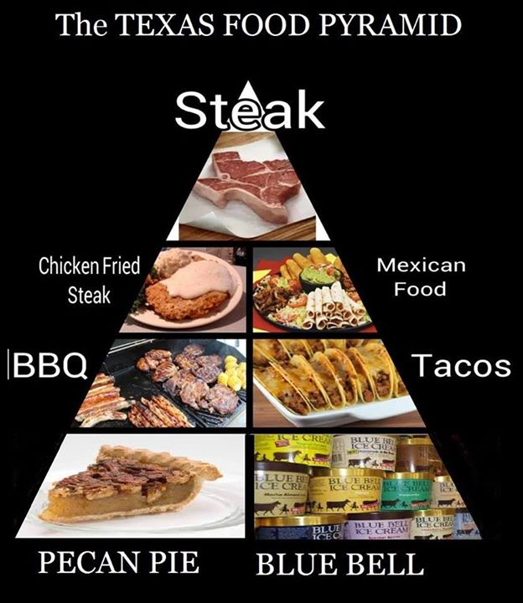
Dining Out in the U.S.
More $$$ than in JP
Large portion sizes
Ask for a ‘to-go box’ and eat left-overs for lunch the next day
Food tends to be saltier and greasier than in Japan. More Meat.
Craving veggies? Try a Vietnamese or Thai restaurant

Slide 36
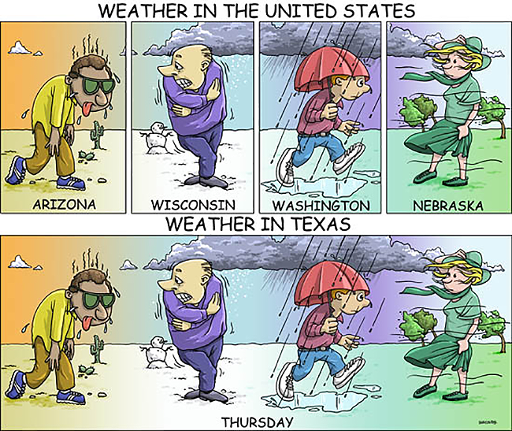
Weather in Houston

Slide 37
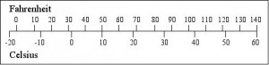
Weather in Houston (cont.)
August & September will be very hot & humid in Houston.
Typically between 90 – 100 degrees Fahrenheit
Heavy Air Conditioning in All Buildings in the U.S.
Bring a light sweater or jacket to put on indoors. It will be much colder inside than what is typical in Japan.
Can rain at any time in Houston. Bring an umbrella or rain poncho with you every day.
If major storms or heavy rain, OISS and Rice will send out email and text announcements to all students & visitors.

Slide 38
Weather During Final Week
Washington, DC
Typically between 75 – 85 degrees Fahrenheit in late September.
Warm during the day, cooler at night.
A/C will still be on in almost all buildings. Bring light-weight sweater to wear indoors.
May need a light-weight jacket for evenings
New York City
Typically between 75 – 85 degrees Fahrenheit in late September.
Warm during the day, cooler at night.
A/C will still be on in almost all buildings. Bring light-weight sweater to wear indoors.
May need a light-weight jacket for evenings

Slide 39
What do I wear?
At Rice University
Casual Attire
Jeans, t-shirts, and sneakers are almost always okay
Some labs may require you wear long pants and closed-toed shoes for safety (e.g. no shorts or sandals)
Dress up a little bit when you first meet your professor (e.g. polo shirt or button-up shirt)
Keep a light-weight jacket or sweater, umbrella, and shoes that can get wet in your lab office or bring with you as weather can change frequently
DC/NYC
Casual attire is also okay for sight-seeing and most outings
Business casual attire for final presentation at Rice and some visits in DC/NYC.
Full suit is not needed, but nice pants and button-up shirt/tie for mean and dress/skirt/slacks with nice top for women.

Slide 40
Other Packing Tips & Questions
Should I bring my PC/Laptop?
Yes, you can use this at night in the hotel to email your friends/family and call via Skype and may need to bring this with you to the research lab to us.
Is there laundry at the hotel?
Yes, there is a coin laundry at the hotel in Houston and you can purchase laundry soap at the grocery store
Bring a Small Medical Kit
Include common medicines you use for headache, cold, allergies, or fever
Medicine in the U.S. has different names than in Japan and the dosage may be stronger/higher than for similar medication in the Japan
Bring only 1 checked suitcase.
You must share a hotel room and you will be charged a check baggage fee for the flight from Houston – DC ($25) and DC – NYC ($25)

Slide 41
Communication in the U.S.
Pre-paid U.S. Cell Phone upon arrival
Already purchased in advance for you. Each student will reimburse Rice University $25 for phone + 500 minutes that are valid for 60 days.
Gives you a U.S. number so you can call the hotel for shuttle pick-up, to use in case of an ER, and so your lab has a phone number they can reach you at.
Japanese Cell Phone
Turn OFF DATA and ROAMING otherwise you may get a very large bill
Use on wi-fi only to make calls or data
Free wi-fi at the hotel in Houston and at Rice
Staying in Touch with Family Friends in Japan
Use SKYPE to make free calls to your family or friends
Make calls via wi-fi or Facetime (for iphone users)
Be sure they are aware of the time difference!

Slide 42
Communication in the U.S. (cont.)
Rice University Email
Will receive a NetID and be able to set up a Rice email address
OISS will use your Rice email address to send you important messages so check it at least once a day
You can continue to use your personal/Japanese address for primary communication.
You are probably already in the Rice University directory.
See https://search.rice.edu/?q=Hiromi+Miwa
Your Rice email will be deactivated within 30 days of your departure from Rice so be sure to set it to forward messages to your Japanese address.

Slide 43
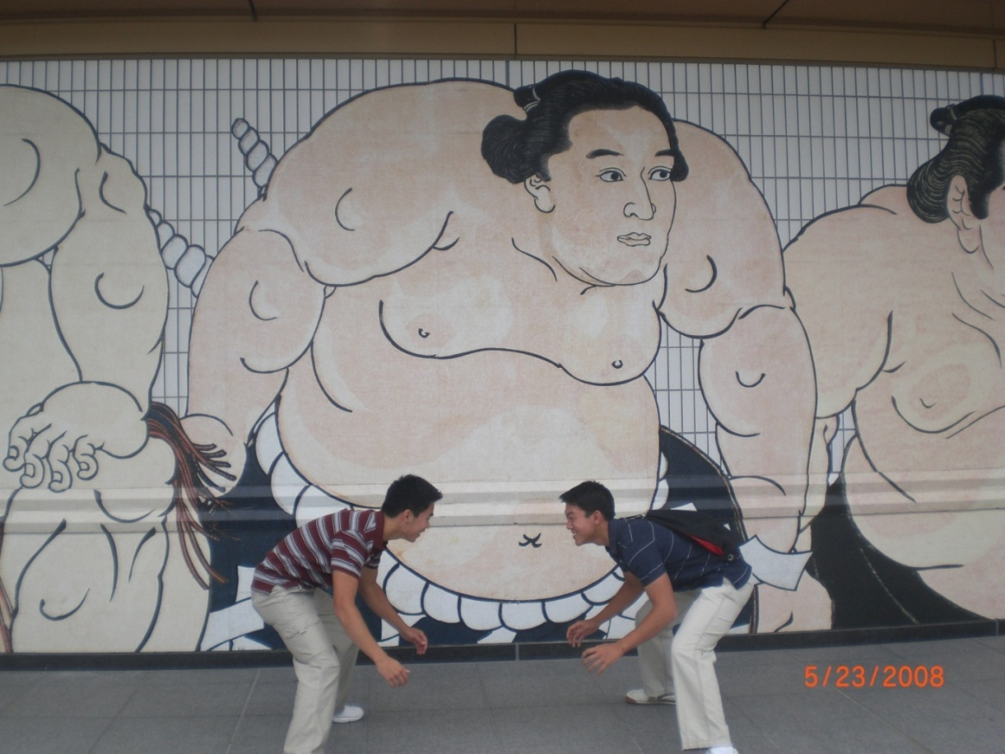
Live by the Rice motto: “Work hard, play hard” = GREAT SUMMER ~ Benjamin Lu, NanoJapan 2008

Slide 44
Helpful Websites: Houston
Visit Houston: http://www.visithoustontexas.com/travel-planning/
Houston: Lonely Planet: http://www.lonelyplanet.com/usa/texas/houston
Houston on the Cheap: http://www.houstononthecheap.com/
For more on Life in the U.S./Houston see our Resources page at http://nakatani-ries.rice.edu/resources/for-japanese-students/life-in-the-u-s/

Slide 45
Questions?
Or email questions to tomodachi-stem@rice.edu

